Slide 1


Slide 2
Robotics Intensive: Rideable Hexapod
Gui Cavalcanti, Dan Cody, James Whong
4/17/2012

Slide 3
Presentation Overview
Wait, what is this place?
Who are these guys?
Oh God, what have I signed up for?
What are we building?
How on earth are we building it?

Slide 4
What is this place?

Slide 5
What is this place?
Artisan’s Asylum, Inc.
Nonprofit community workshop
31,000 square feet
Multiple craft areas
Welding, machining, metalworking, woodworking, electronics assembly, sewing, bicycle repair…
20-25 classes a month

Slide 6
Who are these guys?

Slide 7


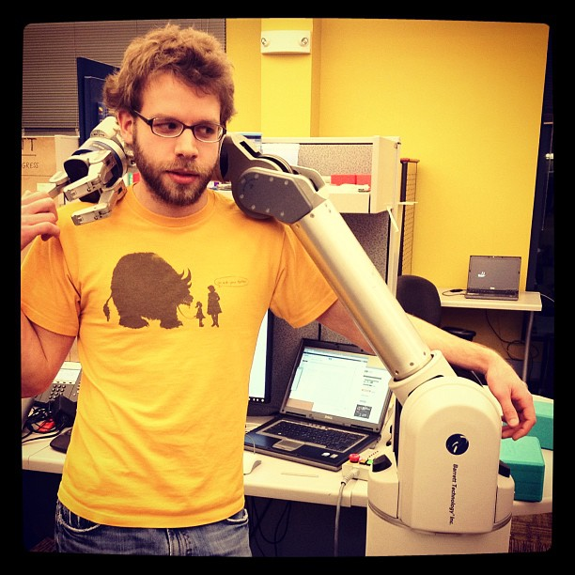
Who are these guys?
Gui Cavalcanti Dan Cody James Whong

Slide 8
Who are these guys?
Olin College of Engineering grads
Professional roboticists
Crazy motherfuckers

Slide 9
Gui Cavalcanti
Mechanical/Systems Engineer
Formerly systems integrator for a $35M, 1,200 pound hydraulic robot horse
Worked on BigDog, PETMAN, LS3 and more
Co-founder and President of Artisan’s Asylum
Makes giant rubber duckies, floating bouncy castles, and dragon sculptures for fun

Slide 10
Dan Cody
Controls/Electrical Engineer
Designer and author of libbarrett, open-source real-time controls library behind WAM arm
Worked on Barrett’s WAM arm, DEKA’s Luke arm, and more
Currently a controls engineer at Barrett Technologies
Dangles from cliff faces for fun

Slide 11
James Whong
Electrical Engineer
Designed distributed electrical control infrastructure for several Boston Dynamics robots
Worked on PETMAN, RCTA, ATLAS, and a number of robots for DEKA, Vision Robotics, and others
Currently an electrical engineer at Boston Dynamics
Punches babies for fun

Slide 12
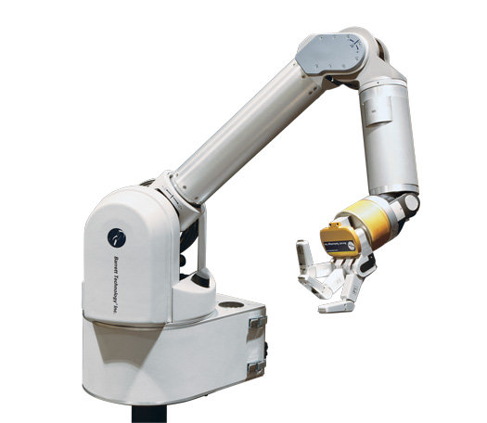
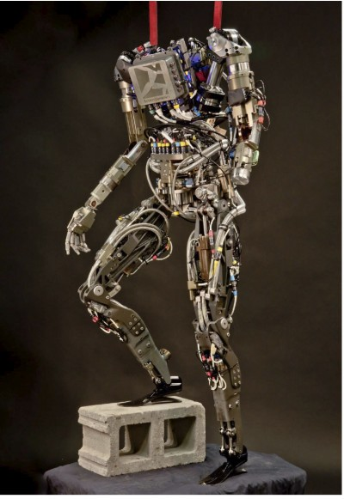
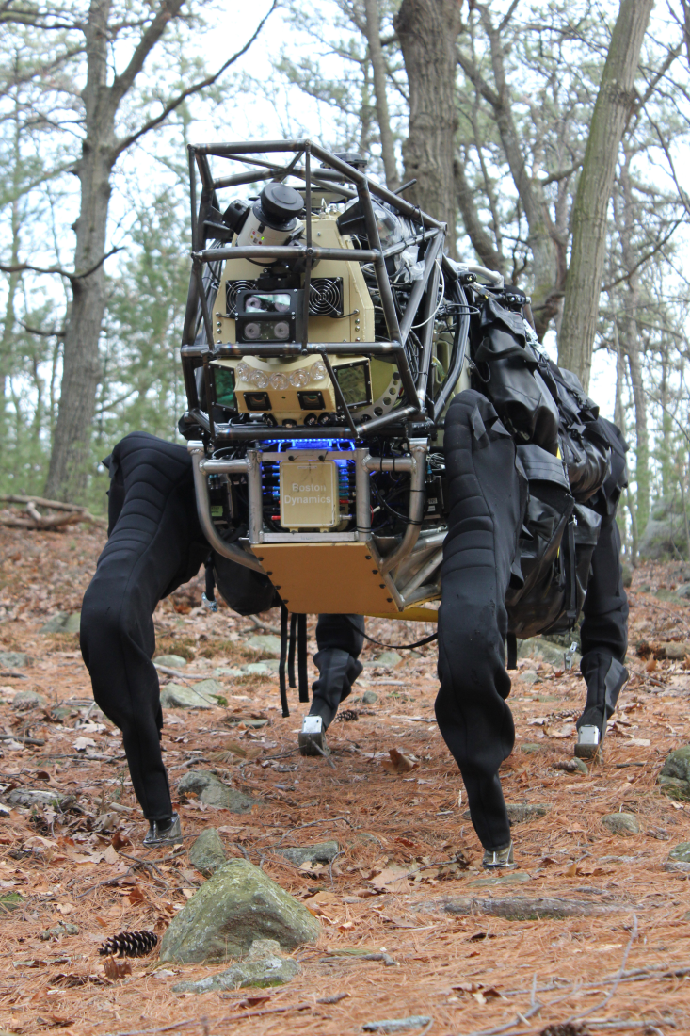
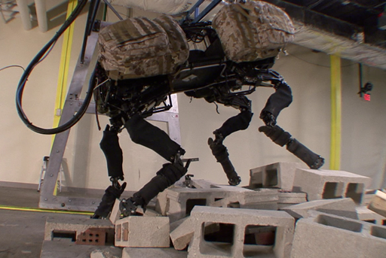
Projects We’ve Worked On

Slide 13
Our Roles
Instructors:
Teach you how to accomplish project goals
Create exercises to guide you through the design process
Critically evaluate and give feedback to your designs and ideas
Project Managers:
Keep the whole project moving and relatively on-schedule
Make high-level systems decisions and review low-level detail decisions
Find and allocate money, time, energy, etc. in the pursuit of ridiculousness

Slide 14
Who are you?

Slide 15
Who Are You?
What’s your name?
What’s your background?
Why do you like robots?
What are you hoping to get out of the class?

Slide 16
What have I signed up for?

Slide 17
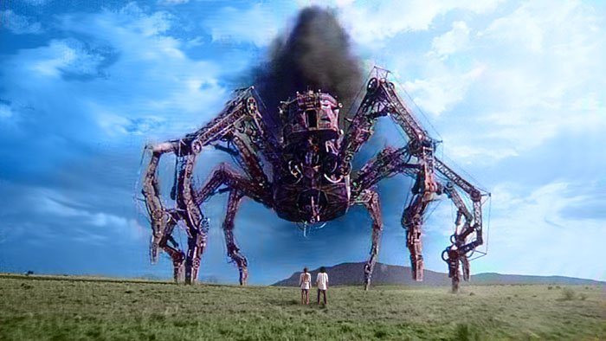
What you’ve signed up for.

Slide 18


A Grand Experiment
+
Public, project-based education

Slide 19
A Grand Experiment
Robots take a ton of the following:
Money
Time
Energy
Informed, correct decisions

Slide 20
A Grand Experiment, Cont.
LS3: $1,500,000 in components, 120,000+ man-hours
PETMAN: $2,000,000 in components, 100,000+ man-hours
BigDog: $500,000 in components, 120,000+ man-hours
Rideable Hexapod: $10,000 in components, 3,000 man-hours

Slide 21
A Grand Experiment
Classes provide
Income from tuition
Fixed, recurring, devoted time with a large group
Energy for learning and creating
Decision-making infrastructure

Slide 22
A Grand Experiment
Design a class to create a giant hexapod
Class income provides $10,000+
Fixed time slots demand recurring attention, large class has a ton of productive capacity
Students get to learn exactly how robots are designed, and practice doing the heavy lifting
Instructors/project managers get to guide a successful project to completion
Everybody wins!

Slide 23
What are we building?

Slide 24
What are we building?

Slide 25
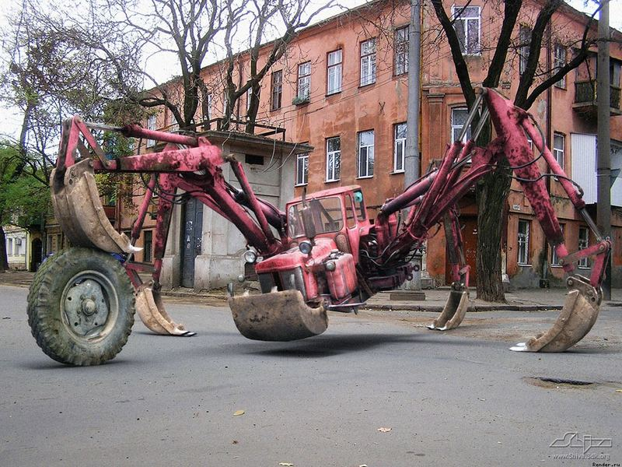
Actually, more like…

Slide 26
Rideable Hexapod
2,500+ pounds
135 horsepower
Propane powered
Hydraulically actuated
15 feet in diameter
1 (2?) person payload

Slide 27
Conceptual Design Decisions
Hydraulic
6 legs
Propane-powered engine system from a large forklift
18 degrees of freedom (actuators)
Force-controlled

Slide 28
Hydraulic
Almost impossible to build at this scale with electric motors
Torque density
Constant amperage draw
Easily achievable with hydraulics, just a question of how fast we can move
Remarkably inexpensive due to glut of heavy lifting equipment

Slide 29
6 Legs
Statically stable gait
Behaves safely if stopped mid-cycle
Impossible to tip over
Allows for several simple gaits
Alternating tripod
Ripple gait
Spreads load out over many legs
Simple inverse kinematics

Slide 30
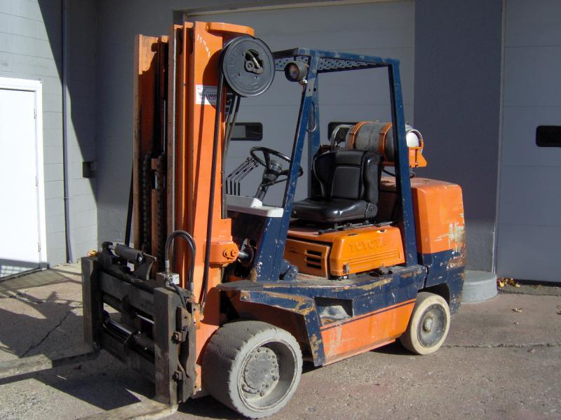
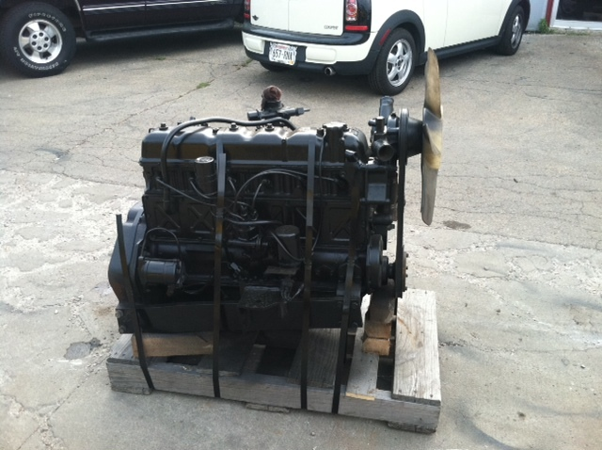
Forklift Powerplant
Need a hydraulic powerplant that can operate both indoors and outdoors
Don’t want to/don’t have time to create our own from scratch
Need high reliability
Need safe fuel system
Forklifts encapsulate all of these needs

Slide 31
18 Degrees of Freedom
3 actuators/degrees of freedom are required to make a leg or arm touch any point in 3D space
We need to control the positions of 6 legs almost perfectly to not damage the ground
6 legs X 3 DOF/leg = 18 DOF

Slide 32
Force-Controlled
We have 6 legs that look like excavators
Excavators are designed to dig into the ground
We need to know where the ground is in order to not destroy it
We need to not be incredibly rigid when we touch the ground
Force control and compliance is the answer

Slide 33
How are we building it?

Slide 34
Teams
Chassis/Powerplant Design Group
Leg Design Group
Electronics Group
Controls Group

Slide 35
Chassis/Powerplant
Primarily systems and mechanical design
Layout of cockpit (and passenger?)
Body shape and structure design
Engine and pump mounting, sensing and supporting systems
Trailer attachments

Slide 36
Leg Design
Primarily mechanical design
Design of mechanical leg structure
Selection of hydraulic actuators
Design of compliance element/force sensor
Foot system design

Slide 37
Electronics
Primarily electrical design
Design of sensing system
Design of actuator control system
Implementation of robust, large scale electronics system
Firmware development

Slide 38
Controls
Primarily programming/control systems
Design of inverse kinematic libraries
Design of several gaits
Tuning of control loops
User input design and control

Slide 39
Design Process

Slide 40
Design Exercises
Mini-Hexapod Race
Leg Cart
Mechanical Build
Electrical Build
Control
Single-Leg Simulation
Excavator Research & Design
HPU Research & Design
Hexapod Simulation
Electrical Routing Design
Quantitative Mechanical Design

Slide 41
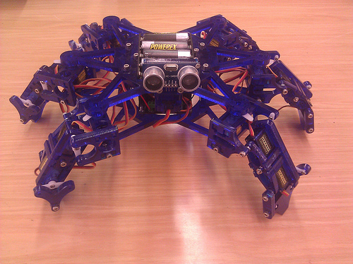
Mini-Hexapod Race
Given a miniature hexapod and control libraries, figure out how to make it go
Navigate a predetermined course fastest and most accurately
Hexapod courtesy of Joe Schlesinger!

Slide 42
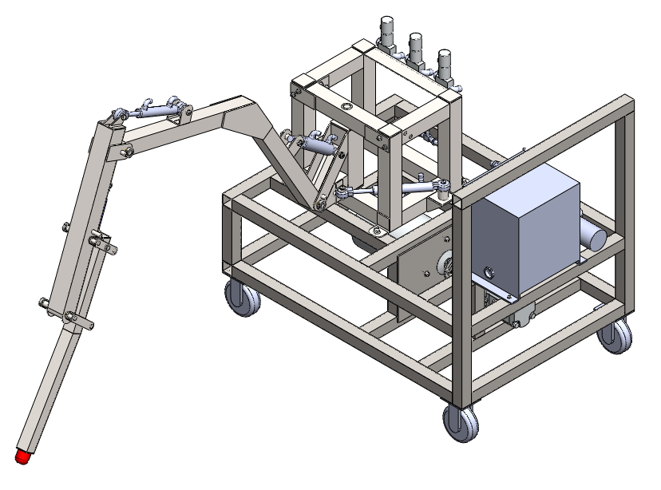
LegCart
Build a cart on “rails” with a single hydraulic leg and electric HPU
Mechanical team gets to assemble hydraulics and work with steel at half-scale
Electrical team gets to wire feedback devices and central processor
Controls team gets to figure out how to wrap a control loop and inverse kinematics around hydraulic hardware

Slide 43
Single-Leg Simulation
Controls team gets a simulator with a leg identical to the Leg Cart
Identical mechanical layout
Representative “electrical” inputs
Gets to prototype inverse kinematics, PID loops, and more in software before moving to hardware

Slide 44
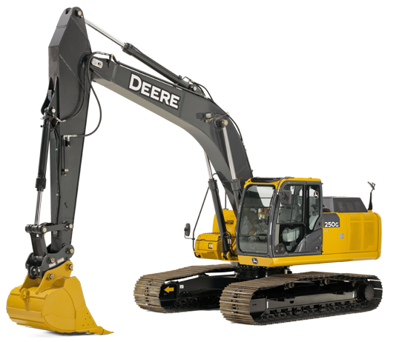
Excavator Research
Leg design team gets to research how excavators are designed
Excavators are hydraulic and designed to push into the ground; let’s figure out why they’re designed the way they are, and steal all the good ideas involved

Slide 45
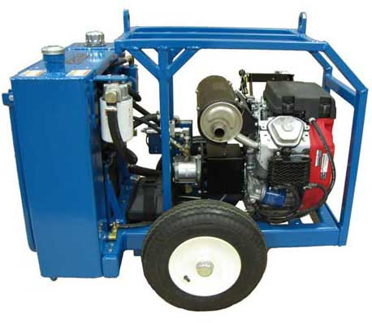
HPU Research
Chassis/Powerplant team gets to figure out how hydraulic power units are designed
Goal for the project is to develop a mobile, propane-powered hydraulic power unit that the rest of the robot attaches to
Team spends a bunch of time at Blake Courtney’s art car shop figuring out how to make the engine go

Slide 46
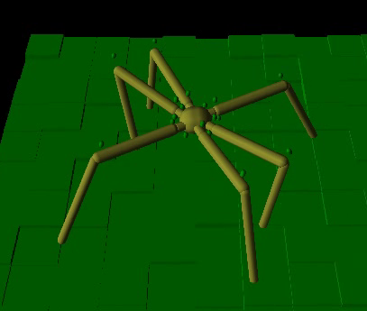
Hexapod Simulation
Once we have somewhat representative values for weights, link sizes, flow rates, pressures, etc., a representative hexapod simulation is made
Controls team develops gaits and places actuators in software in order to inform mechanical design

Slide 47
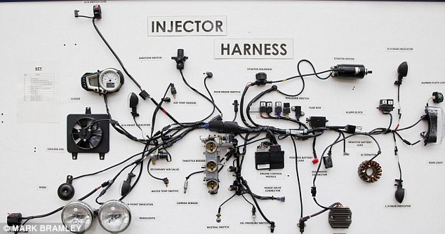
Electrical Routing Design
How the hell do we get electrical cables everywhere we need them without ripping them off the robot?

Slide 48
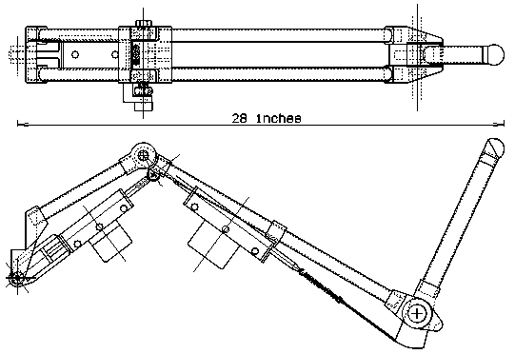
Quantitative Mechanical Design
Given the results of the simulation, select cylinders, cylinder placements, and leg designs that will create a mechanical plant as close to the simulation requirements as possible

Slide 49
And then we build. Forever.

Slide 50
Questions?

Slide 51
Splitting Up
LegCart Mechanical Build
Go see Gui for assignments
Mini Hexapod Race
Go see James and Dan

